Slide 1
Introduction to Deep Learning: How to make your own deep learning framework
Ryota Tomioka (ryoto@microsoft.com)
MSR Summer School
2 July 2018
Azure iPython Notebook https://notebooks.azure.com/ryotat/libraries/DLTutorial

Slide 2
Agenda
This lecture covers
Introduction to machine learning (keywords: model, training, inference, stochastic gradient descent, overfitting)
How to compute the gradient (keywords: backpropagation, multi-layer perceptrons, activation function)

Slide 3
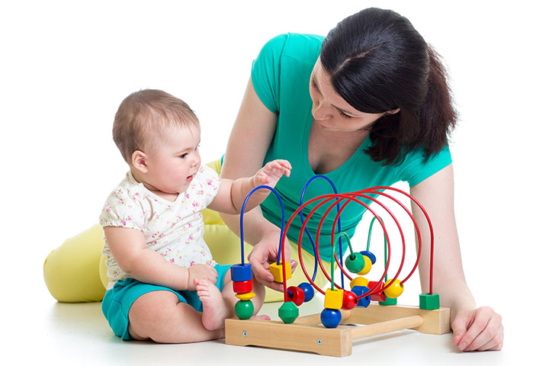
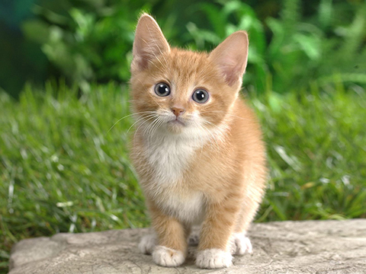
What is Machine Learning (ML)?
The goal of ML is to learn from data ---->
Technically, combines statistics and computational tools (optimization)
Example (supervised learning) tasks
Model
Cat or Dog
Image recognition / classification

Slide 4
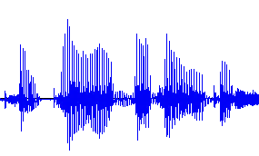
What is Machine Learning (ML)?
The goal of ML is to learn from data ---->
Technically, combines statistics and computational tools (optimization)
Example (supervised learning) tasks
Model
“Hello”
Speech recognition

Slide 5
What is Machine Learning (ML)?
The goal of ML is to learn from data ---->
Technically, combines statistics and computational tools (optimization)
Example (supervised learning) tasks
Model
“How are you?”
“Wie geht’s dir?”
Machine translation

Slide 6
What is Machine Learning (ML)?
The goal of ML is to learn from data ---->
Technically, combines statistics and computational tools (optimization)
Example (supervised learning) tasks
Model
“How are you?”
“I am fine thank you”
Conversational agent / chatbot

Slide 7
What is Machine Learning (ML)?
The goal of ML is to learn from data ---->
Technically, combines statistics and computational tools (optimization)
Example (supervised learning) tasks
Cat or Dog
Model
“Wie geht’s dir?”
“How are you?”
“I am fine thank you”

Slide 8
What is Machine Learning (ML)?
The goal of ML is to learn from data ---->
Technically, combines statistics and computational tools (optimization)
Example (supervised learning) tasks
Image recognition
Speech recognition
Machine translation
Other form of learning
Unsupervised learning
Reinforcement learning
Cat or Dog
“Hello”
“Hello”
“Bonjour”

Slide 9
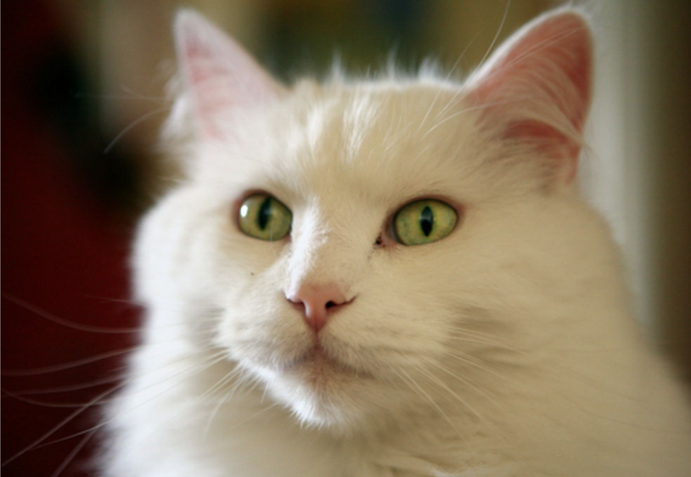
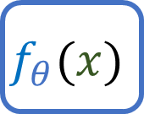

Training and inference
Training
The loss tells what the output of the model should have been
Training objective can be overly optimistic (overfitting)
Inference (validation)
We care about the performance in this setting
cat
$$f_{θ}(x)$$
Loss
$$f_{θ}(x)$$
0.1
(dog)
Frozen
parameter
0.99
(cat)
Training data

Slide 10


Slide 11
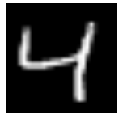
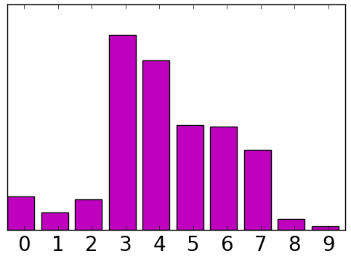
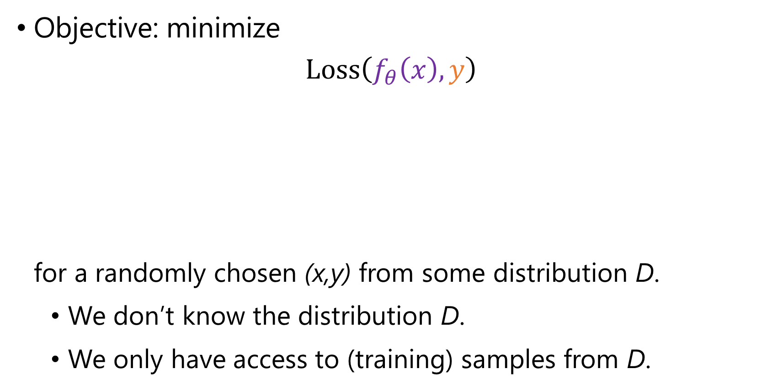
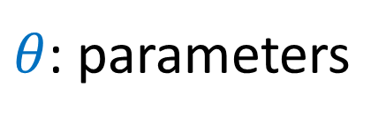
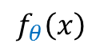
Learning objective
Objective: minimize $\text{Loss}\left(f_{θ}\left(x\right), y\right)$ for a randomly chosen (x,y) from some distribution D.
We don’t know the distribution D.
We only have access to (training) samples from D.
model
$$f_{θ}\left(x\right)$$
$θ$: parameters
4
input x
prediction
label

Slide 12
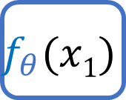

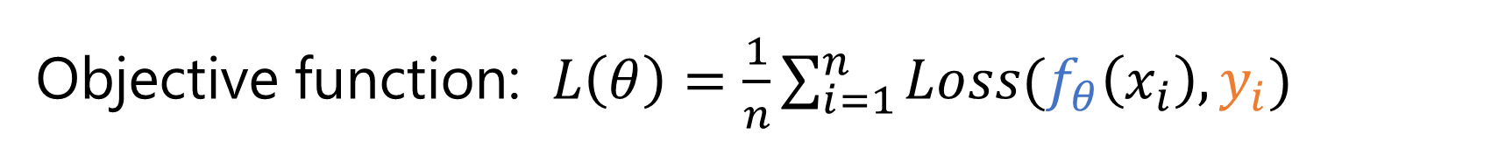
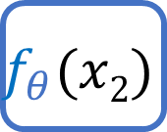
Training objective
Objective function: $L\left(θ\right)=\frac{1}{n}\sum_{i=1}^{n}{Loss(f_{θ}\left(x_{i}\right), y_{i})}$
Approximate the unknown distribution D with the training data average
( , 4)
$$f_{θ}(x1)$$
Loss
+
Training data
( , 5)
$$f_{θ}(x2)$$
Loss

Slide 13

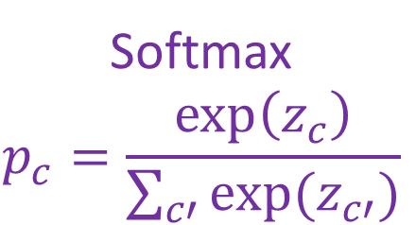
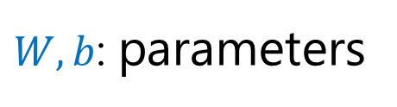
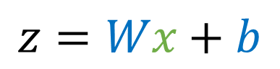
Mapping from input to prediction
input x
score z
probability p
$W,b$: parameters
$$z=Wx+b$$
Softmax $$p_{c}=\frac{\exp\left(z_{c}\right)}{\sum_{c′}{exp⁡(z_{c′})}}$$
784 dim
10 dim
10 dim

Slide 14
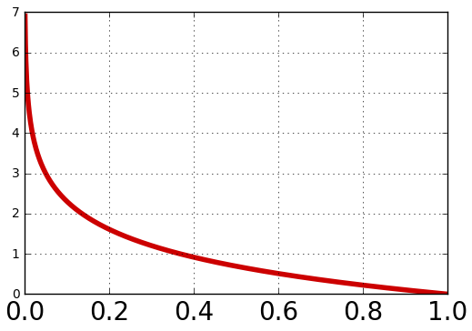
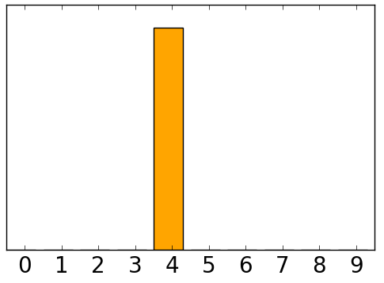
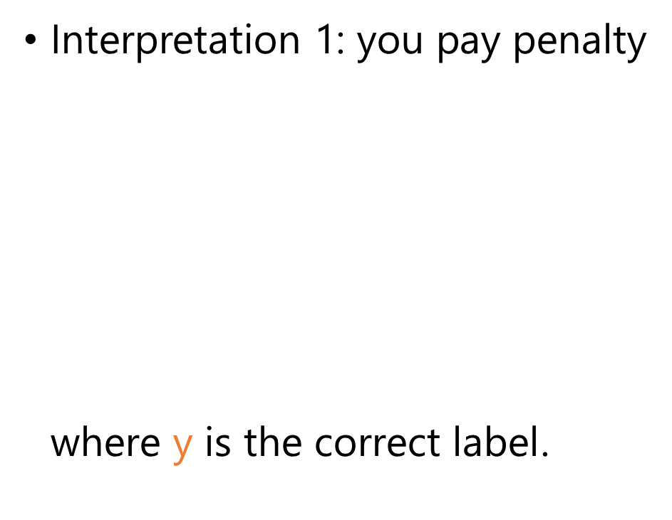
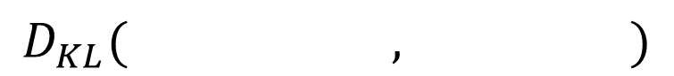
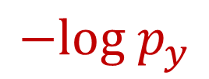
Cross-entropy loss
Interpretation 1: you pay penalty $\text{where} \text{y} \text{is} \text{the} \text{correct} \text{label}$.
Interpretation 2: Kullback-Leibler divergence
$$−log p_{y}$$
$$D_{KL}(mmmmmm,mmmmm)$$
All the probability mass on the correct label (‘4’)
prediction

Slide 15
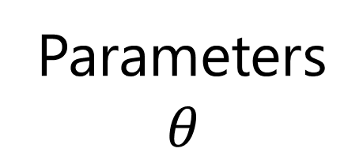
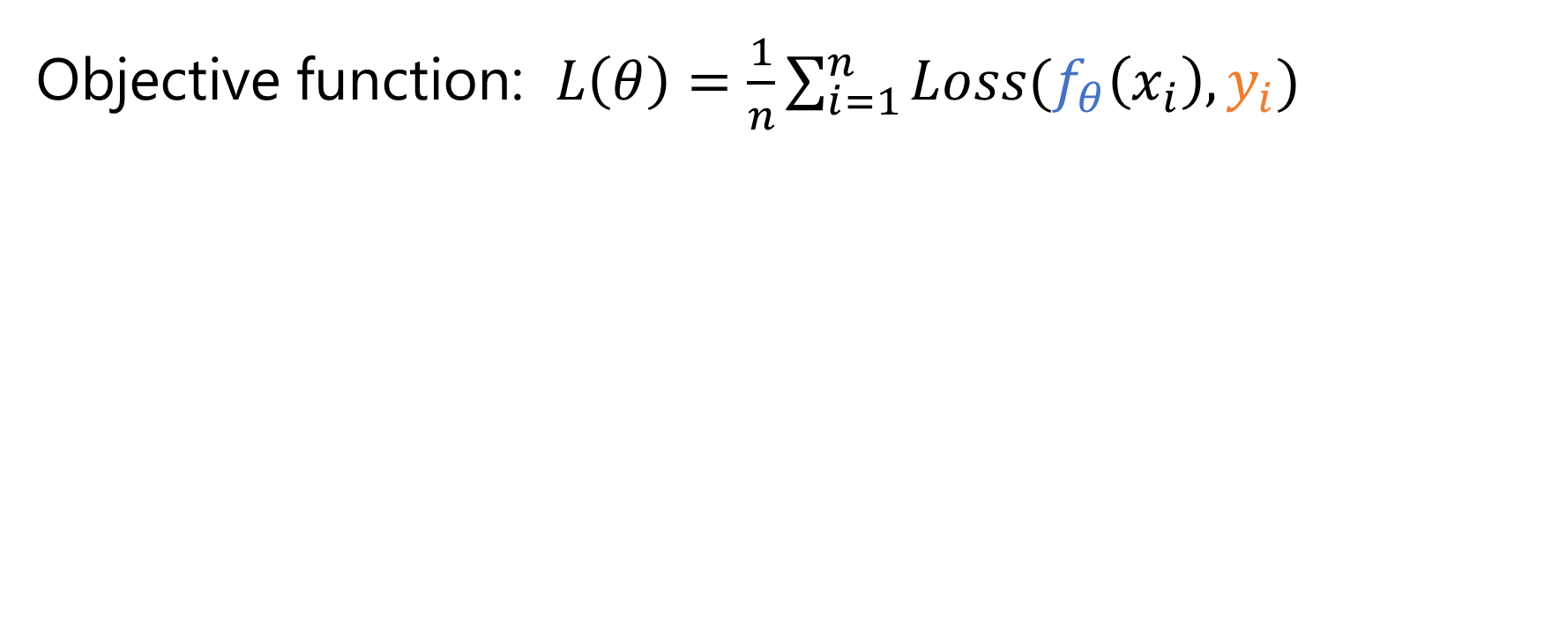
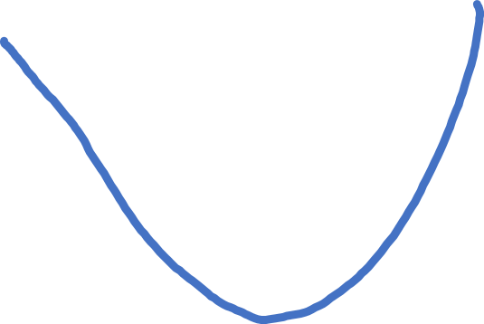
Landscape of training objective
Objective function: $L\left(θ\right)=\frac{1}{n}\sum_{i=1}^{n}{Loss(f_{θ}\left(x_{i}\right), y_{i})}$
Parameters $$θ$$
Initial parameters
final parameters

Slide 16
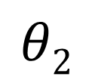
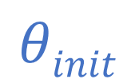
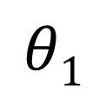

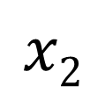
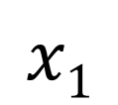
Landscape of training objective
Parameter space
Example space
$$θ2$$
$$x2$$
$$θinit$$
$$θinit$$
$$θ1$$
$$x1$$

Slide 17
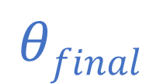

Landscape of training objective
Parameter space
Example space
$$θ2$$
$$x2$$
$$θfinal$$
$$θinit$$
$$θfinal$$
$$θ1$$
$$x1$$

Slide 18
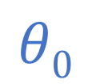
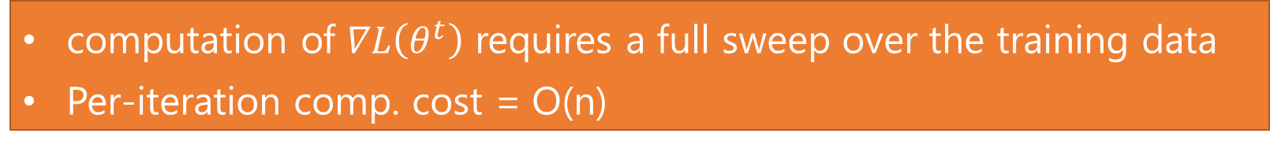
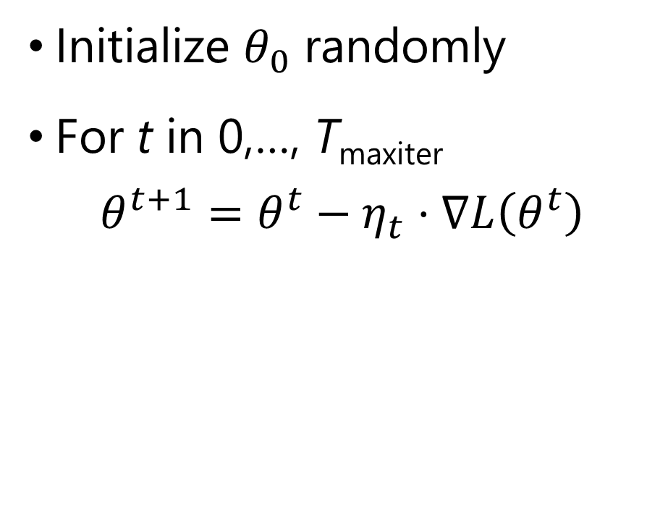
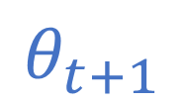
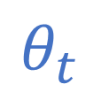
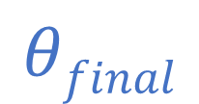
Gradient descent
$$θ_{t}$$
Initialize $θ_{0}$ randomly
For t in 0,…, T_{maxiter}
$$θ^{t+1}=θ^{t}−η_{t}⋅∇L\left(θ^{t}\right)$$
$$θ_{t+1}$$
$$θfinal$$
$$θ0$$
Gradient of the objective
Learning rate (step size)
computation of $∇L\left(θ^{t}\right)$ requires a full sweep over the training data
Per-iteration comp. cost = O(n)

Slide 19
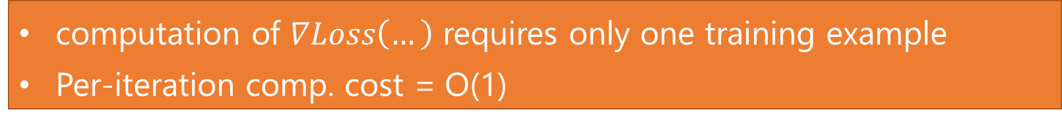
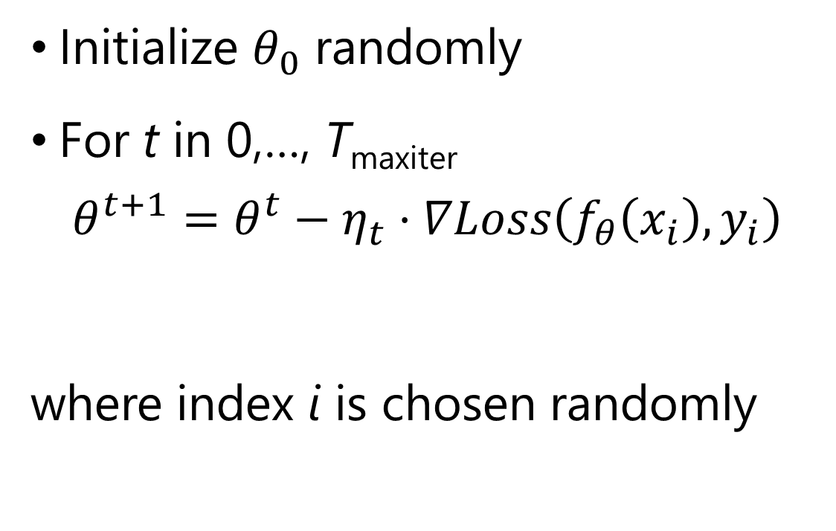
Stochastic gradient descent (SGD)
$$θ_{t}$$
Initialize $θ_{0}$ randomly
For t in 0,…, T_{maxiter}
$$θ^{t+1}=θ^{t}−η_{t}⋅∇Loss\left(f_{θ}\left(x_{i}\right), y_{i}\right)$$
where index i is chosen randomly
$$θ_{t+1}$$
$$θfinal$$
$$θ0$$
Stochastic gradient
computation of $∇Loss\left(…\right)$ requires only one training example
Per-iteration comp. cost = O(1)

Slide 20
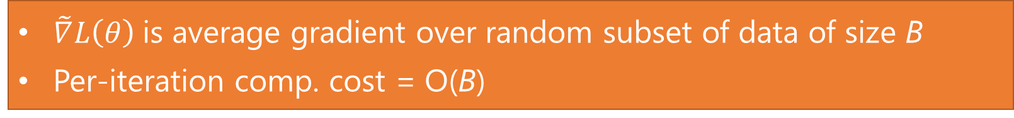
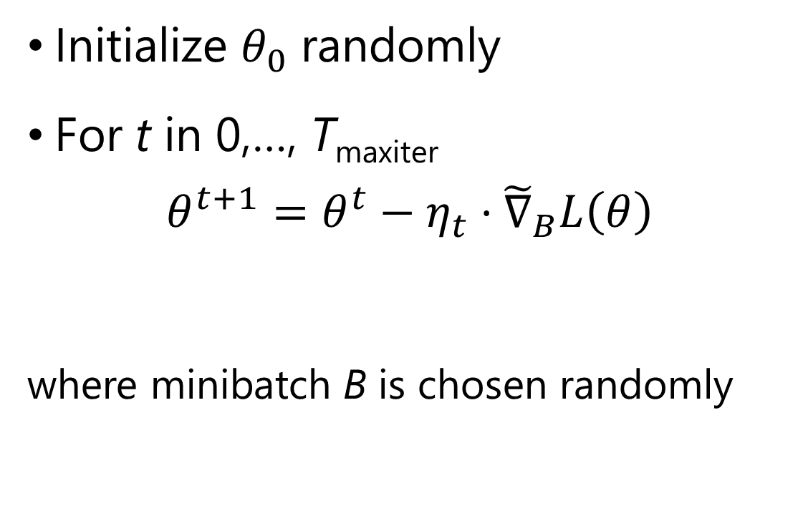
Minibatch stochastic gradient descent
$$θ_{t}$$
Initialize $θ_{0}$ randomly
For t in 0,…, T_{maxiter}
$$θ^{t+1}=θ^{t}−η_{t}⋅{\tilde{∇}}_{B}L\left(θ\right)$$
where minibatch B is chosen randomly
$$θ_{t+1}$$
$$θfinal$$
$$θ0$$
minibatch gradient
$\tilde{∇}L\left(θ\right)$is average gradient over random subset of data of size B
Per-iteration comp. cost = O(B)

Slide 21
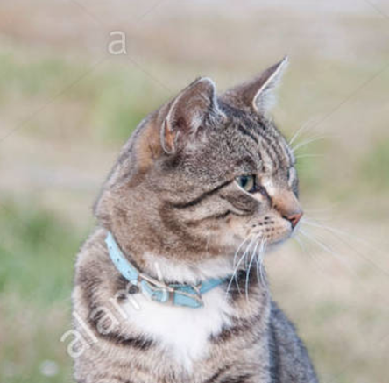
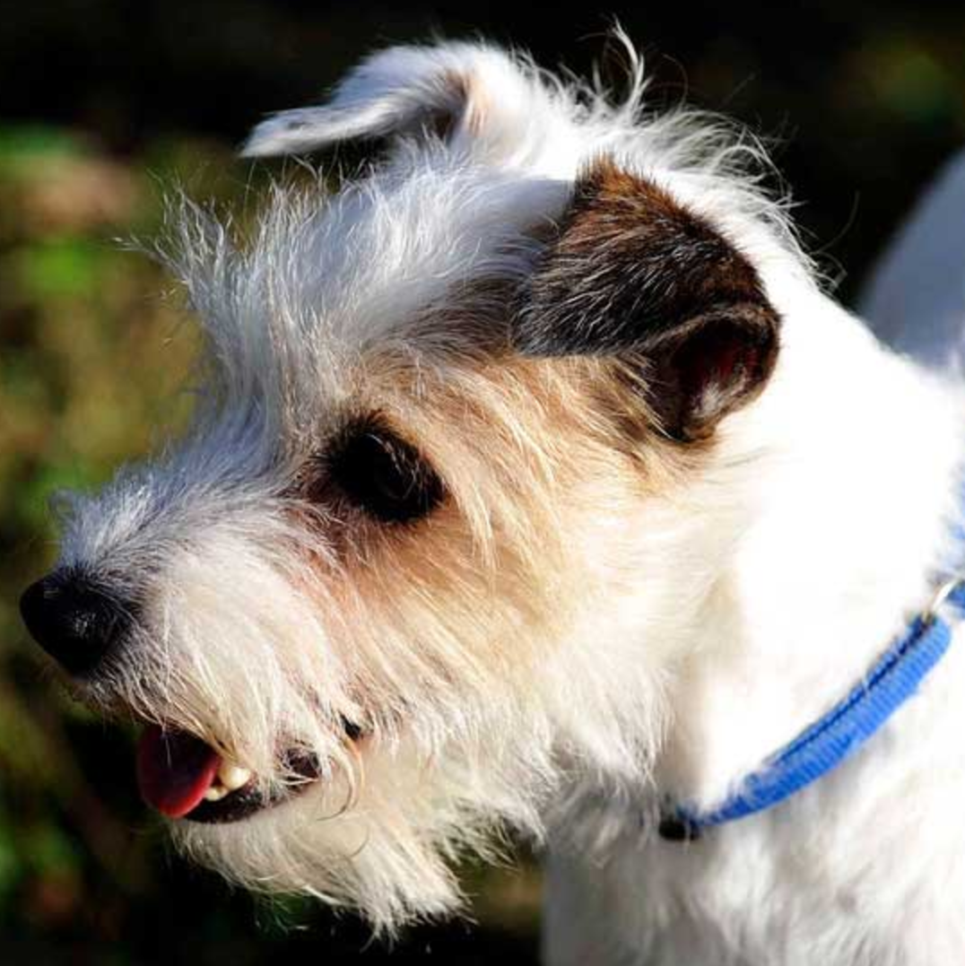
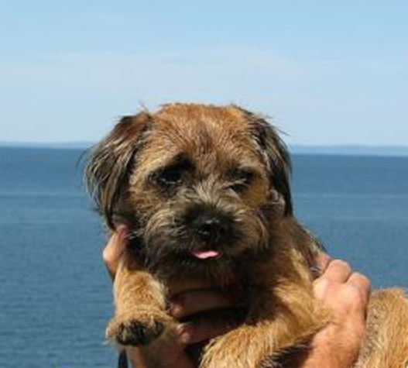

Overfitting – what is signal vs noise?
Validation data
Imagine:
Powerful models are more likely to overfit
We need validation data: leave out some portion of the training data to validate the generalizability of the model
cat
Training data
dog

Slide 22
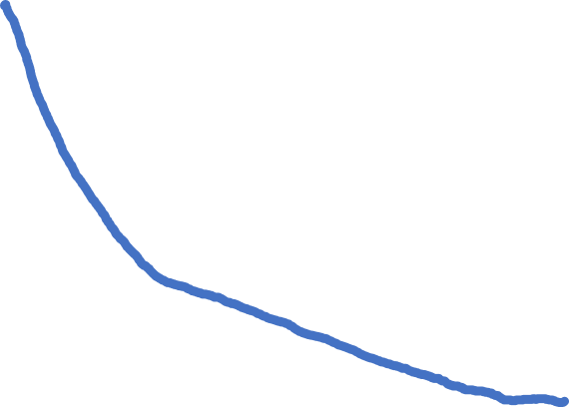
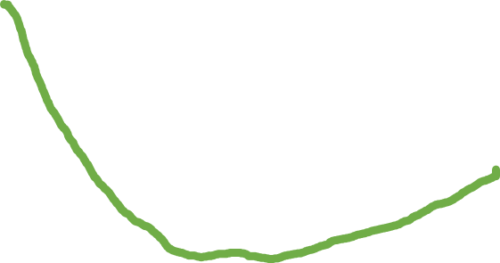
Typical learning curve
Validation loss
Training loss
Number of training steps

Slide 23
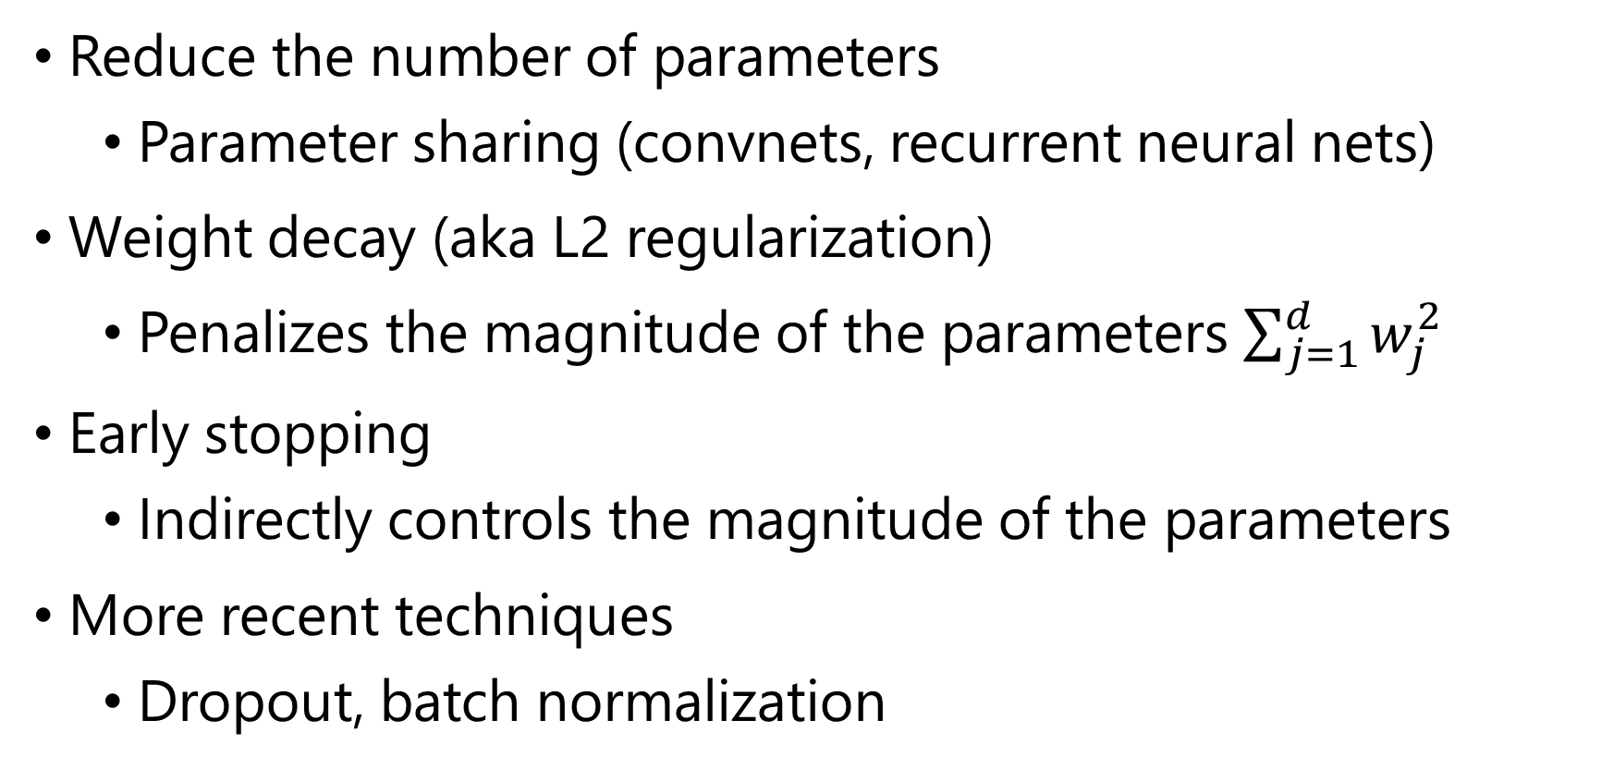
Techniques to reduce overfitting
Reduce the number of parameters
Parameter sharing (convnets, recurrent neural nets)
Weight decay (aka L2 regularization)
Penalizes the magnitude of the parameters $\sum_{j=1}^{d}{w_{j}^{2}}$
Early stopping
Indirectly controls the magnitude of the parameters
More recent techniques
Dropout, batch normalization

Slide 24
Summary so far
A machine learning problem can be specified by:
Task: What’s the input? What’s the output?
Model: maps from the input to some numbers
Loss function: measures how the model is doing
Training: mini-batch SGD on the sum of empirical losses
Validation: Are we overfitting?

Slide 25
How do we compute the gradient?

Slide 26
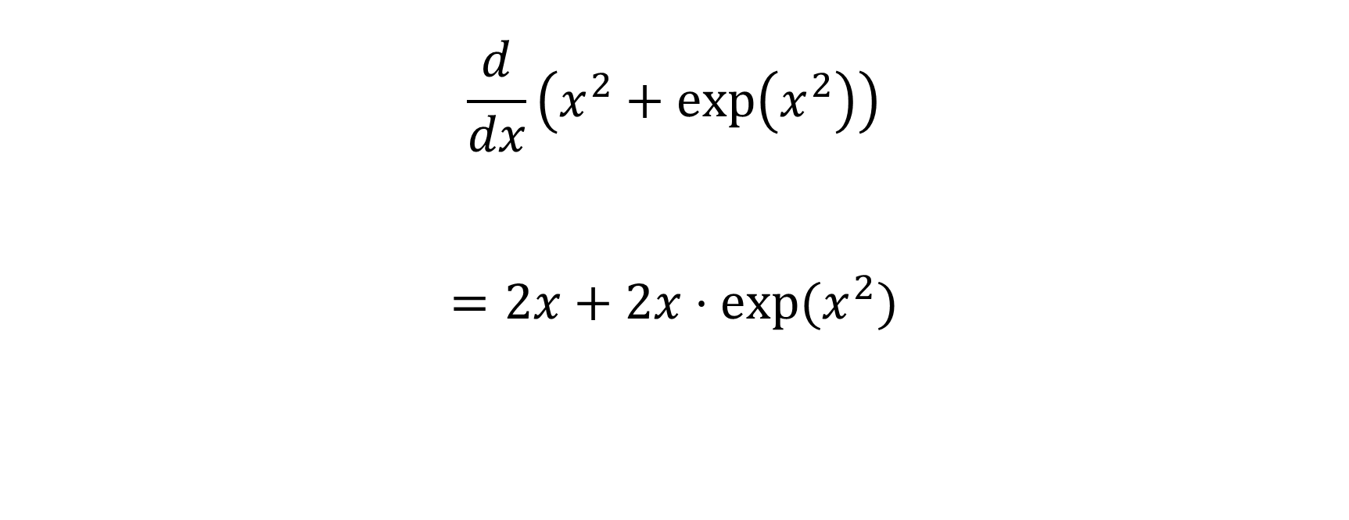
Add
$$\frac{d}{dx}\left(x^{2}+\exp\left(x^{2}\right)\right)$$
$$=2x+2x⋅exp(x^{2})$$
Square
Exp
Square
x

Slide 27
Add
$$\frac{d}{dx}\left(x^{2}+\exp\left(x^{2}\right)\right)$$
$$=2x+2x⋅exp(x^{2})$$
Mul
Exp
Mul
x

Slide 28
How do we compute the gradient?
Manually
Tedious (model specific), error prone, and not easy to explore new models
Algorithmically
Back-propagation
Allow researchers to focus on model building rather than implementing each model correctly

Slide 29
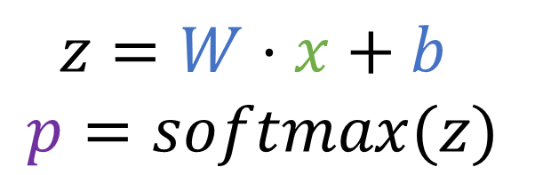

Back propagation for the linear predictor
Identify how each variable influence the loss
x
z
p
Loss
$z=W⋅x+b$
$$p=softmax(z)$$
w
b

Slide 30
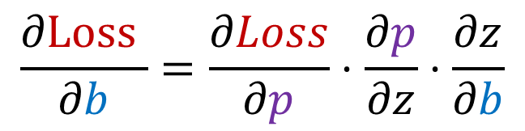
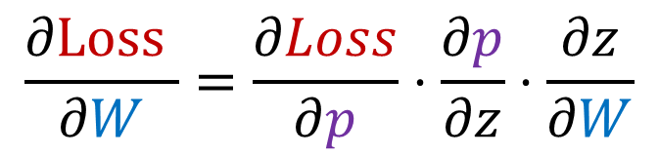
Back propagation for the linear predictor
Identify how each variable influence the loss
$$\frac{∂\text{Loss} }{∂W}=\frac{∂Loss}{∂p}⋅\frac{∂p}{∂z}⋅\frac{∂z}{∂W}$$
x
z
p
Loss
$$\frac{∂\text{Loss} }{∂b}=\frac{∂Loss}{∂p}⋅\frac{∂p}{∂z}⋅\frac{∂z}{∂b}$$
w
b

Slide 31


Back propagation
Don’t repeat shared compute. Propagate the gradients backward
$$\frac{∂\text{Loss} }{∂W}=\frac{∂Loss}{∂p}⋅\frac{∂p}{∂z}⋅\frac{∂z}{∂W}$$
x
z
p
Loss
$$\frac{∂\text{Loss} }{∂b}=\frac{∂Loss}{∂p}⋅\frac{∂p}{∂z}⋅\frac{∂z}{∂b}$$
w
b

Slide 32






Back propagation
Don’t repeat shared compute. Propagate the gradients backward
$$∆z=Δp⋅\frac{∂p}{∂z}$$
$$∆p=\frac{∂Loss}{∂p}$$
$$\frac{∂\text{Loss} }{∂W}=\frac{∂Loss}{∂p}⋅\frac{∂p}{∂z}⋅\frac{∂z}{∂W}$$
x
z
p
Loss
$$∆W=Δz⋅\frac{∂z}{∂W}$$
$$∆b=Δz⋅\frac{∂z}{∂b}$$
$$\frac{∂\text{Loss} }{∂b}=\frac{∂Loss}{∂p}⋅\frac{∂p}{∂z}⋅\frac{∂z}{∂b}$$
w
b

Slide 33
Going deeper

Slide 34





Going deeper
$W_{0},b_{0},W_{1},b_{1}$: parameters
$W_{0},b_{0},W_{1},b_{1}$: parameters
pre-
hidden h_{in}
input x
pre-
hidden h_{in}
input x
hidden h
hidden h
score z
score z
probability p
probability p
$$h_{in}=W_{0}x+b_{0}$$
$$h_{in}=W_{0}x+b_{0}$$
$$z=W_{1}h+b_{1}$$
$$z=W_{1}h+b_{1}$$
ReLU
ReLU
Softmax
Softmax
784 dim
784 dim
1024 dim
1024 dim
1024 dim
1024 dim
10 dim
10 dim
10 dim
10 dim

Slide 35

Activation functions
Rectified Linear Unit (ReLU) $h=\max\left(0, h_{in}\right)$
Hyperbolic tangent (tanh)
$$h=tanh⁡(h_{in})$$
Sigmoid
$$h=\frac{1}{1+e^{−h_{in}}}$$

Slide 36
XOR problem

Slide 37
Rectified linear unit (ReLU)

Slide 38
Rectified linear unit (ReLU)

Slide 39
Rectified linear unit (ReLU)

Slide 40
Rectified linear unit (ReLU)

Slide 41
Rectified linear unit (ReLU)

Slide 42

Comparison to tanh
Gradient can flow backwards
“ReLU is non-saturating”
Gradient is almost zero in these areas

Slide 43




Chain rule
$$\frac{∂\text{Loss} }{∂W_{1}}=\frac{∂Loss}{∂p}⋅⋯⋅\frac{∂z}{∂W_{1}}$$
Identify how each variable influence the loss
$$\frac{∂\text{Loss} }{∂b_{1}}=\frac{∂Loss}{∂p}⋅⋯⋅\frac{∂z}{∂b_{1}}$$
x
h_{in}
h
z
p
Loss
$$\frac{∂\text{Loss} }{∂W_{0}}=\frac{∂Loss}{∂p}⋅⋯⋅\frac{∂h_{in}}{∂W_{0}}$$
W₀
b₀
W₁
b₁
$$\frac{∂\text{Loss} }{∂b_{0}}=\frac{∂Loss}{∂p}⋅⋯⋅\frac{∂h_{in}}{∂b_{0}}$$

Slide 44








Back propagation
Don’t repeat shared compute - Propagate the gradients backward
$$∆h_{in}=Δh⋅\frac{∂h}{∂h_{in}}$$
$$∆h=Δz⋅\frac{∂z}{∂h}$$
$$∆z=Δp⋅\frac{∂p}{∂z}$$
$$∆p=\frac{∂Loss}{∂p}$$
x
h_{in}
h
z
p
Loss
Linear
ReLU
Linear
Softmax
W₀
b₀
W₁
b₁
$$∆W_{0}=Δh_{in}⋅\frac{∂h_{in}}{∂W_{0}}$$
$$∆b_{0}=Δh_{in}⋅\frac{∂h_{in}}{∂b_{0}}$$
$$∆W_{1}=Δz⋅\frac{∂z}{∂W_{1}}$$
$$∆b_{1}=Δz⋅\frac{∂z}{∂b_{1}}$$

Slide 45










More complex example
$$∆h=Δz⋅\frac{∂z}{∂h}$$
$$∆h=Δz_{0}⋅\frac{∂z_{0}}{∂h}+Δz⋅\frac{∂z}{∂h}$$
$$∆h_{in}=Δh⋅\frac{∂h}{∂h_{in}}$$
$$∆z_{0}=Δz⋅\frac{∂z}{∂z_{0}}$$
$$∆z=Δp⋅\frac{∂p}{∂z}$$
$$∆p=\frac{∂Loss}{∂p}$$
x
h_{in}
h
z₀
z
p
Loss
Linear
ReLU
Linear
Softmax
W₀
b₀
W₁
b₁
$$∆W_{0}=Δh_{in}⋅\frac{∂h_{in}}{∂W_{0}}$$
$$∆b_{0}=Δh_{in}⋅\frac{∂h_{in}}{∂b_{0}}$$
$$∆W_{1}=Δz_{0}⋅\frac{∂z_{0}}{∂W_{1}}$$
$$∆b_{1}=Δz_{0}⋅\frac{∂z_{0}}{∂b_{1}}$$

Slide 46
Demo

Slide 47





Deep learning frameworks
Collection of implementations of popular layers (or modules), e.g., ReLU, Softmax, Convolution, RNNs
Provides an easy front-end to the layers/modules
Handles different array libraries / hardware backends (CPUs, GPUs, …)
If there were an exchange format…

Slide 48


Slide 49



Books
Convex Optimization
Stephen Boyd and Lieven Vandenberghe
Cambridge University Press
Information Theory, Inference and Learning Algorithms
David J. C. MacKay
2003
Neural Networks for Pattern Recognition
Christopher M. Bishop

Slide 50
Conclusion
Training a network consists of
Forward propagation: computing the loss
Backward propagation: computing the gradient
Parameter update: move in the direction of the computed stochastic gradient
Fairly standard set of building blocks are used to build complex models
Linear, ReLU, Softmax, Tanh, …
Advanced topics
How to prevent overfitting
How to scale neural network training to multiple machines / devices

Slide 51
Advanced topics

Slide 52
Minibatch size and convergence speed
1 pass over the dataset (1 epoch)
Parameter update
Full-batch gradient descent
Error
#samples
Large-minibatch gradient descent
Error
#samples
Small-minibatch gradient descent
Error
#samples

Slide 53


Effect of minibatch size B
Learning rate $η$ scaled as $η=0.025⋅\sqrt{B}$

Slide 54
Dropout –randomly drops activations during training
Instance 1

Slide 55
Dropout –randomly drops activations during training
Instance 2

Slide 56
Dropout –randomly drops activations during training
Instance 3

Slide 57
Dropout
Idea: randomly drop activations during training
Benefit: reduces overfitting and improves generalization
Can be implemented as a layer

Slide 58



Batch normalization
Inputs scaled to [0,1]
Weights and biases
drawn from
N(0, 1)
R.V. with scale
at most $\sqrt{784}$
784 dim
1024 dim

Slide 59









Batch normalization
Inputs scaled to [0,1]
R.V. with scale
at most $\sqrt{784}$
Weights and biases
drawn from
N(0, 1)
R.V. with scale
at most $\sqrt{784}$
$$μ_{1}$$
$$σ_{1}$$
$$μ_{2}$$
$$σ_{2}$$
$$μ_{3}$$
$$σ_{3}$$
$$μ_{H}$$
$$σ_{H}$$
784 dim
1024 dim

Slide 60
Batch normalization [Ioffe &Szegedy, 2015]
Idea: normalize the activation of each unit to have zero mean and unit standard deviation using a mini-batch estimate of mean and variance.
Benefit: more stable and faster training. Often generalizes better
Can be implemented as a layer

Slide 61
More optimization algorithms
Momentum SGD: improves SGD by incorporating “momentum”

Slide 62
Adaptive optimization algorithms
Adam [Kingma & Ba 2015]: uses first and second order statistics of the gradients so that gradients are normalized
Benefit: prevents the vanishing/exploding gradient problem

Slide 63

Learning rate decay
Reduce the learning rate or step-size parameter ($η$) once in a while
Typical setting: multiply 0.98 to $η$ every epoch.

Slide 64
Summary
Training and inference
Training objective and optimization
Neural networks and backpropagation
Importance of software tools – turns research into Lego block engineering
Various tricks to speed-up training and reduce overfitting

Slide 65










Gradient explosion/diminishing problem
$$h_{0}$$
$$h_{1}$$
$$h_{2}$$
$$h_{3}$$
Linear + ReLU
Linear + ReLU
Linear + ReLU
$$W_{1}$$
$$W_{2}$$
$$W_{3}$$
$$W_{1}^{T}$$
$$W_{2}^{T}$$
$$W_{3}^{T}$$

Slide 66














Gradient explosion/diminishing problem
$$h_{0}$$
$$h_{1}$$
$$h_{2}$$
$$h_{3}$$
Linear
Linear
Linear
$$W_{}$$
$$W_{}$$
$$W_{}$$
$$W_{}^{T}$$
$$W_{}^{T}$$
$$W_{}^{T}$$
$${Δh}_{0}={\left(W_{}^{T}\right)}^{3}Δh_{3}$$
$${Δh}_{1}={\left(W_{}^{T}\right)}^{2}Δh_{3}$$
$${Δh}_{2}=W_{}^{T}Δh_{3}$$
$${Δh}_{3}$$
Gradient is magnified or diminished by factor W at every layer.
If we have many layers, they can explode or diminish to zero.

Slide 67


What is a model?
A model is a function specified by a set of parameters $θ$
Example: linear predictor $f_{θ}\left(x\right)=wT⋅x+b (θ=\left(w,b\right))$
$$f_{θ}(x)$$
0.99
parameters

Slide 68






What is a model?
A model is a function specified by a set of parameters $θ$
Example: linear predictor $f_{θ}\left(x\right)=wT⋅x+b (θ=\left(w,b\right))$
parameters
w₁
$$×$$
x₁
w₂
$$×$$
x₂
= sum
w₃
x₃
+
b
$$×$$
w₄
$$×$$
x₄
w₅
$$×$$
x₅

Slide 69
Training and inference
Training
The loss tells what the output of the model should have been
Training objective can be overly optimistic (overfitting)
Inference (validation)
We care about the performance in this setting
cat
$$f_{θ}(x)$$
Loss
$$f_{θ}(x)$$
0.1
(dog)
Frozen
parameter
0.99
(cat)
Training data

Slide 71






Loss functions for binary classification
p=prediction, y=ground truth (0 or 1)
Miss classification loss (-accuracy)
Squared loss
Cross entropy loss
$$I(\left(p−0.5\right)⋅(y−0.5))$$
$${\left(p−y\right)}^{2}$$
$$−y⋅log\left(p\right) \\ −\left(1−y\right)⋅log(1−p)$$

